Slide 1
Indian Classical Literature
Rasa
Dr. Tuhin Majumdar
Department of English
Khatra Adibasi Mahavidyalaya
2nd Sem ,2017-18
Course Code: UG-ENG- 202/C-4

Slide 2
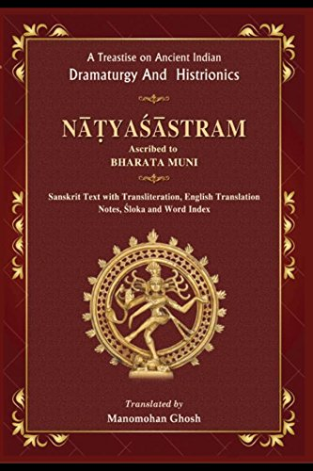
Bharat Muni & Natyasastra
The pole star of Indian aesthetics, Bharat Muni, mentions the word ‘rasa’ in chapters VI and VII of his monumental work Natyasastra, which is a compendium of
performing arts

Slide 3
Rasa: Connotations
‘Rasa’ has been translated etymologically by the terms ‘flavour’, ‘relish’, ‘taste’ or ‘saveur’.
According to Bharata, “that which is relished is rasa”.
It ranges from the Aryan’s drinking of the ‘soma juice’ to the yogis’ communion with the metaphysical Absolute.
According to Pramod Kale, Bharata’s rasa theory:
“a framework of rules and regulations, to explain and achieve an effective communication, a rapport between the performers and the spectators.”

Slide 4
Rasa-nispattih
Rasa is produced/realized (rasa-nispattih) from a combination (samyoga) of Determinants (vibhava), Consequents (anubhava) and Complementary Psychological States (vyabhicaribhava); and their union with the sthayibhava (Durable Psychological State).
Just as the taste results from a combination of various spices, vegetables and other articles, similarly the Durable Psychological State when combined with other Psychological states culminates into rasa wherein no constituent is experienced separately but all together are experienced as one whole being.

Slide 5
Determinant (Vibhava)
Determinant (Vibhava) is synonymous with Karana (cause), nimitta (instrument), hetu (reason). It determines the emotions and moods to be aroused in the reader or spectator.
G.B. Mohan is of the opinion that it may be described as Eliot’s ‘objective correlative.
Alambana vibhava (Dependent) is the person or the object which is primarily responsible for the arousal of emotions.
The Uddipana vibhava (Excitant) is the environment which stimulates the emotive effect of the focal point.
In Kalidasa’s Abhijnana Sakuntalam, when Dusyanta falls in love with Sakuntala at the hermitage of Kanva, Sakuntala becomes the Alambana vibhava and the entire forest with beautiful hermitage and pleasant breeze serves as Uddipana vibhava.

Slide 6
Consequent (Anubhava)
Consequent (Anubhava) is the external manifestation of the provocation of the Sthayibhaba. It is so called because what is represented on the stage is made to be felt and experienced by the spectators.
There are two types of anubhava—voluntary and involuntary.
The voluntary anubhava is the movements of eyes and eyebrows which are supposed to be willful expression of our emotion for its proper communication.
The involuntary anubhava is the change of colour and blush which automatically arise following the emergence of emotion in our heart.

Slide 7
Complementary Psychological States
(Vyabhicaribhava)
Vyabhicaribhava does not have an independent status of its own. It acts just as the feeder of the Sthayibhava and strengthens it. There are thirty three Complementary Psychological States, some of which are:
Despondency (nirveda)
Weakness (glani)
Apprehension (sanka)
Envy (asuya)
Anxiety (cinta)
Death (marana)
Cruelty (ugrata)
Joy (harsa) etc.

Slide 8
Complementary Psychological States
(Vyabhicaribhava)
“And he repulsed…..
Fell into sadness, then into a fast,
…..thence into a weakness….
Thence to a lightness, and by this declension
Into the madness….”
Polonius in Shakespeare’s Hamlet describes the impact of Ophelia’s separation on Hamlet through these lines. These frequent changes shown in the physical as well as the mental states of Hamlet are nothing but the vyabhicaribhava.

Slide 9
Durable Psychological State
(STHAYIBHAVA)
According to Bharata, there are eight Sthayibhava—Love (rati), Laughter (hasya), Sorrow (soka), Anger (krodha), Energy (utsaha), Fear (bhaya), Disgust (jugupsa), Astonishment (vismaya).
P.V. Kane elucidates that Sthayibhava is like the ocean which is ocassionally disturbed by other bhavas but always retains its own position. It does not loose its individuality and finally matures into rasa.
Bharata opines that Sthayibhava is like the king whereas other bhavas are like subjects.
It exists permanently in our mind, says R. Gnoli, “in the form of latent impressions derived from actual experiences in the present life or from inherited instincts”.

Slide 10
Sentiments (Rasa-s)
According to Bharata, there are eight sentiments (rasa-s):
Erotic (srngara)
Comic (hasya)
Pathetic (karuna)
Furious (raudra)
Heroic (vira)
Terrible (bhayanaka)
Odious (bibhatsa)
Marvellous (adbhuta)
Bharata in chapter VI of Natyasastra explains the Sthayibhavas of eight sentiments; their determinants, consequents, complementary psychological states and their nature of combination leading to the realization of rasa.

Slide 11
THE EROTIC SENTIMENT
(Srngara rasa)
Durable Psychological State—Love (rati)
Determinants—Pleasant seasons, Beautiful garlands, Fine ornament, Company of intimate fellows
Consequent—Represented on the stage are clever movement of the eyes, eyebrows, glances, soft and delicate movement of limbs, sweet and pleasant words
There are two types of Erotic sentiments—union (Samyoga) and separation (vipralambha).
Consequents of separation (vipralambha)—fear, jealousy, fatigue, anxiety, dreaming, insanity, indifference

Slide 12
THE COMIC SENTIMENT
(Hasya rasa)
Durable Psychological State—Laughter
Determinants—putting on unusual dress, quarrel, uncouth behaviour and use of irrelevant words
Consequents—opening the eyes wide or contracting them, perspiration, throbbing of lips and nose etc
Complementary psychological states—indolence, dissimulation, insomnia, envy etc.

Slide 13
THE PATHETIC SENTIMENT
(Karuna rasa)
Durable Psychological State—Sorrow
Determinants—Suffering under a curse, separation from or loss of dear ones, commotion caused by death, captivity, reversal of situation and other misfortunes
Consequents—heaving of sigh, shedding of tears, paralysis, loss of memory etc.
Complementary Psychological States—Epilepsy, depression, languor, anxiety, dejection, distraction death, insanity etc.

Slide 14
THE FURIOUS SENTIMENT
(Raudra rasa)
Durable Psychological State—Anger (krodha)
Determinants—indignation, rape, insult, false allegation, revenge etc.
Consequents—biting one’s lip, red eyes, trembling, frowning, drawing of weapons etc
Complementary Psychological States—indignation, intoxication, restlessness, fury, horripilation etc.

Slide 15
THE HEROIC SENTIMENT
(Vira rasa)
Durable Psychological State—Energy (utsaha)
Determinants—good conduct, determination, courage, discipline etc.
Consequents—firmness, pride, patience
Complementary Psychological States—pride, contentment, judgment etc.

Slide 16
THE TERRIBLE SENTIMENT
(Bhayanaka rasa)
Durable Psychological State—Fear (bhaya)
Determinants—loss of courage, sight of ghosts, death, terrible cries of owls and jackals, staying in an empty house or forest
Consequents—trembling, sweating, fainting etc.
Complementary Psychological States—depression, distraction, stupefaction, palpitation, dryness of lips etc.

Slide 17
THE ODIOUS SENTIMENT
(Bibhatsa rasa)
Durable Psychological State—Disgust
Determinants—disgusting sight, taste, smell and sound which create uneasiness
Consequents—contraction of mouth and eyes, covering the nose, spitting, vomiting etc.
Complementary Psychological States—epileptic fit, agitation, sickness etc.

Slide 18
THE MARVELLOUS SENTIMENT
(Adbhuta rasa)
Durable Psychological State—astonishment (vismaya)
Determinants—supernatural things and illusions.
Consequents— exclamation of surprise, weeping, stammering etc.
Complementary Psychological States—sentiment are joy, agitation, choking voice etc.

Slide 19
Santa Rasa
The admission of Santa rasa as the ninth rasa has led to a good deal of controversy among critics. However, Abhinavagupta considers it as ‘maharasa’.
Sthayibhava—sama
Determinants—pursuit for spiritual knowledge and freedom from worldly desire.
Consequents—Meditation, devotion, recognition of truth etc.
Complementary psychological states—courage, fixity etc.

Slide 20
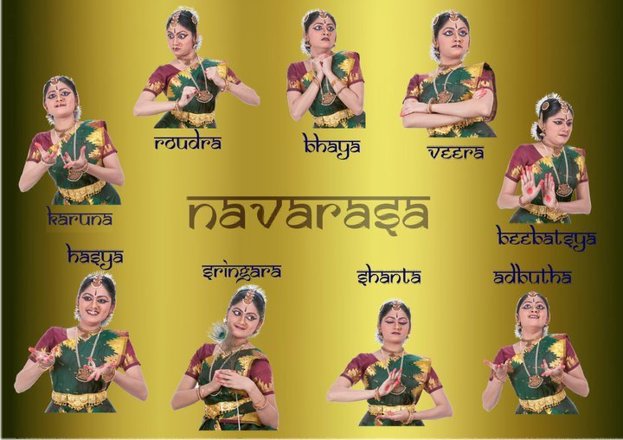
Navarasa: Bharatnatyam Gestures

Slide 21
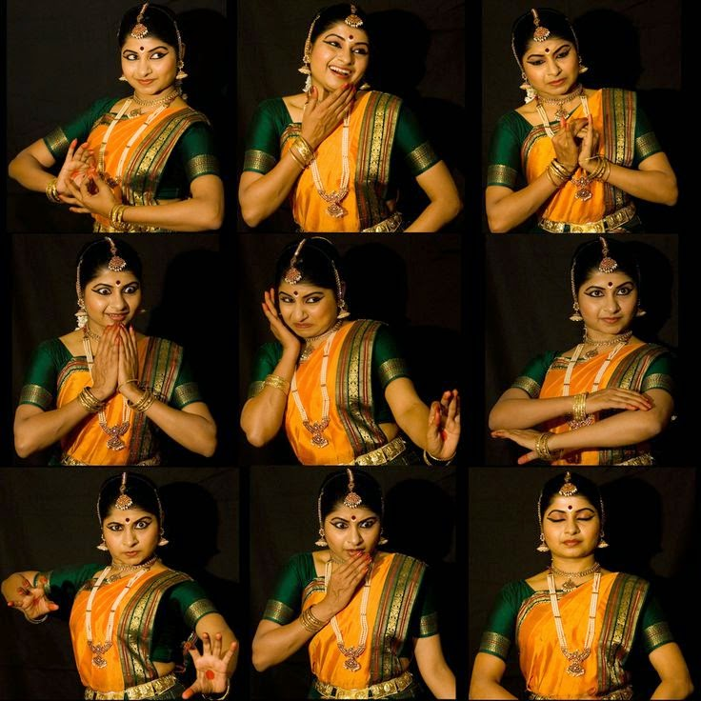
Navarasa: Bharatnatyam Gestures

Slide 22
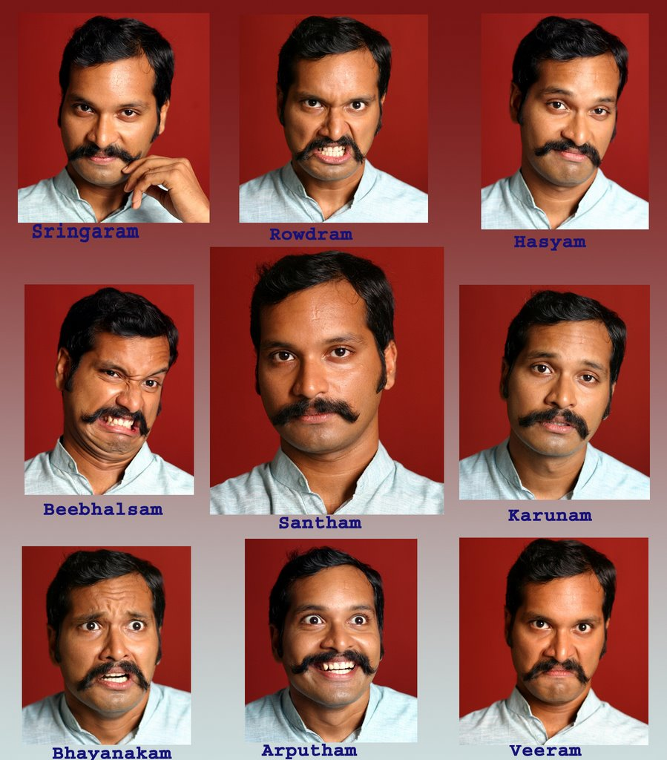
Navarasa: day-to-day Gestures

Slide 23
Conclusion
Rasa is therefore regarded as the cardinal principle of Indian aesthetics.
Rasa, which came to be understood as the ultimate aesthetic delight experienced by the reader/listener/spectator, is regarded as the touch-stone of any creative art. Both in Drama and in Kavya, Rasa is not a mere means but is the desired end or objective that is enjoyed by the the cultured spectator or the reader.

